Slide 1

Story of Dagmar, Dana and Oliver
Playing- 2-gether: Teacher sensitivity
as a basis for inclusion in preschool
2017-1-SK01-KA201-035321

Slide 2
How the story begins
Dagmar - a preschool teacher with 30 year
of experience
Dana - a preschool teacher with 25 years of
experience
Thinking about „suitable“ child
A child with challenging behaviour
Why Oliver – a short description
Interview on teacher – child relationship
3 characteristic words about Oliver
Teachers´ feelings

Slide 3
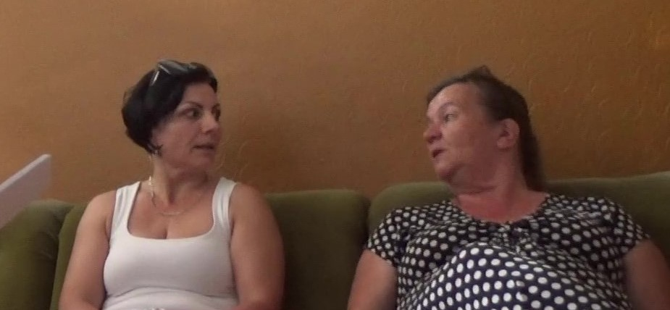
Interview both teachers worked with Oliver in the class

Slide 4
Training on P-2-G
12 weeks training on Playing-2-gether in class
Interactions and building the emotional bonds in play
Try-outs of P-2-G skills
Filming the interactions in play
Coaching sessions

Slide 5
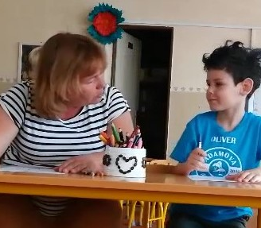
Dana and Oliver
Building a sensitive and responsive relationship
through
play

Slide 6
P-2-G skills
How did it go on?
Which skills were difficult to manage?
What to do with Don´t skills?
What do I learnt?

Slide 7
How the story ends
Feelings about Oliver
Changes in his behaviour
„One self-confident, independent, happy boy“
Story continues... he is 1st grader at primary school, but still visiting his teachers in kindergarten

Slide 8
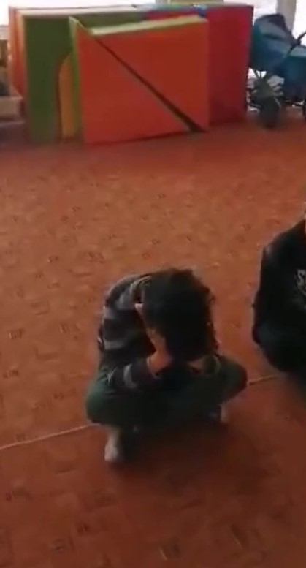
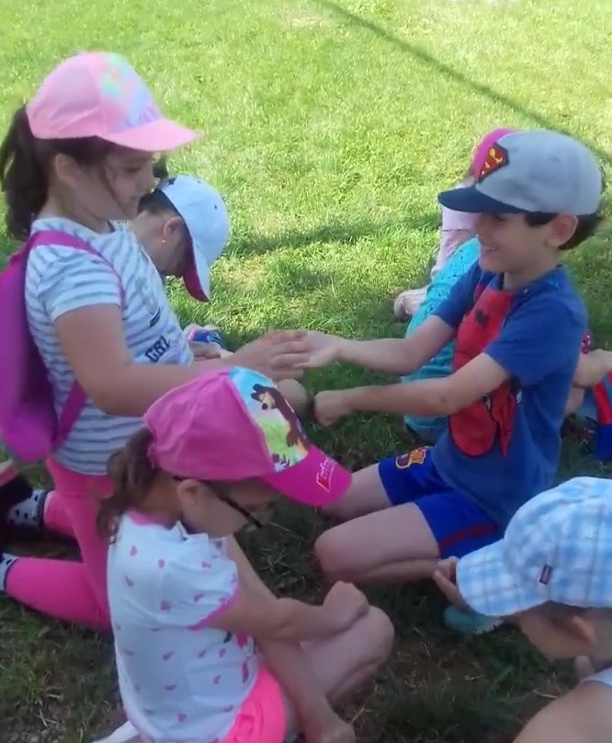
Oliver before and after intervention through P-2-G

